Slide 1

Inventory
Organized by:
WAHIA ASMA
NASSER DOUNIA
Supervised by:
Pr.Mohamemed NASRI

Slide 2
Contents
■ Representing organizational value chains via a series of dimensional models
■ Semi-additive facts
■ Three fact table types: periodic snapshots, transaction, and accumulating snapshots
■ Enterprise data warehouse bus architecture and bus matrix
■ Opportunity/stakeholder matrix
■ Conformed dimensions and facts, and their impact on agile methods
■ Importance of data governance

Slide 3
Introdction
this chapter provides a thorough discussion of the enterprise data warehouse bus architecture. The bus architecture is essential to creating an integrated DW/BI system. It provides a framework for planning the overall environment, even though it will be built incrementally. We will underscore the importance of using common conformed dimensions and facts across dimensional models, and will close by encouraging the adoption of an enterprise data governance program.

Slide 4
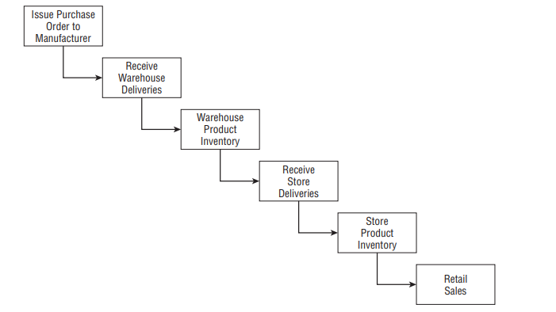
Value Chain Introduction
Most organizations have an underlying value chain of key business processes. The value chain identifies the natural, logical flow of an organization’s primary activities. For example, a retailer issues purchase orders to product manufacturers. The products are delivered to the retailer’s warehouse, where they are held in inventory. A delivery is then made to an individual store, where again the products sit in inventory until a consumer makes a purchase
Operational source systems typically produce transactions or snapshots at each step of the value chain the value chain provides high-level insight into the overall data architecture for an enterprise DW/BI environment

Slide 5
Inventory Models
In the meantime, we’ll discuss several complementary inventory models. The first is the inventory periodic snapshot where product inventory levels are measured at regular intervals and placed as separate rows in a fact table. second inventory model where every transaction that impacts inventory levels as products move through the warehouse is recorded

Slide 6
Inventory Periodic Snapshot
The business process we’re interested in analyzing is the periodic snapshotting of retail store inventory. The most atomic level of detail provided by the operational inventory system is a daily inventory for each product in each store. The dimensions immediately fall out of this grain declaration: date, product, and store. This often happens with periodic snapshot fact tables where you cannot express the granularity in the context of a transaction, so a list of dimensions is needed instead.

Slide 7
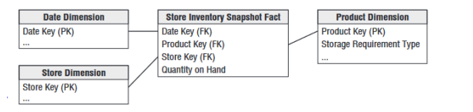
Inventory Periodic Snapshot

Slide 8
Semi-Additive Facts
In the inventory snapshot schema, the quantity on hand can be summarized across products or stores and result in a valid total. inventory levels, however, are not additive across dates because they represent snapshots of a level or balance at one point in time. Because inventory levels (and all forms of financial account balances) are additive across some dimensions but not all, we refer to them as semi-additive facts

Slide 9
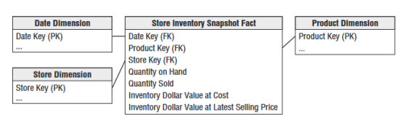
Enhanced Inventory Facts
The simplistic view in the periodic inventory snapshot fact table enables you to see a time series of inventory levels. For most inventory analysis, quantity on hand isn’t enough. Quantity on hand needs to be used in conjunction with additional facts to measure the velocity of inventory movement and develop other interesting metrics such as the number of turns and number of days’ supply

Slide 10
Inventory Transactions
A second way to model an inventory business process is to record every transaction that affects inventory. Inventory transactions at the warehouse might include the following:
■ Receive product.
■ Place product into inspection hold.
■ Release product from inspection hold.
■ Return product to vendor due to inspection failure.
■ Place product in bin.
■ Pick product from bin.
■ Package product for shipment.
■ Ship product to customer.
■ Receive product from customer.
■ Return product to inventory from customer return.
■ Remove product from inventory

Slide 11
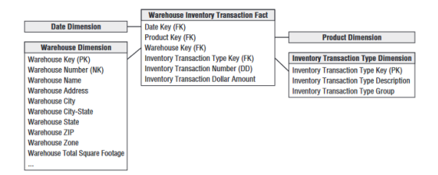
Inventory Transactions
Each inventory transaction identifies the date, product, warehouse, vendor, transaction type, and in most cases, a single amount representing the inventory quantity impact caused by the transaction. Assuming the granularity of the fact table is one row per inventory transaction
The transaction fact table is useful for measuring the frequency and timing of specific transaction types to answer questions that couldn’t be answered by the less granular periodic snapshot.

Slide 12
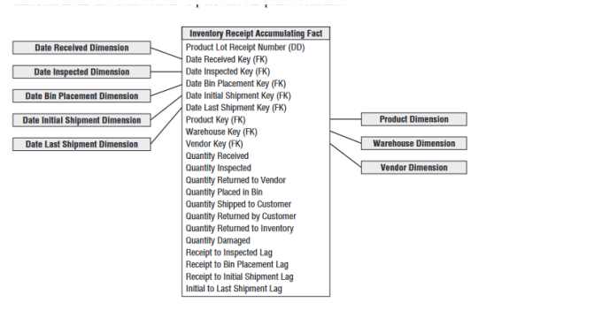
inventory Accumulating Snapshot
The final inventory model is the accumulating snapshot. Accumulating snapshot fact tables are used for processes that have a definite beginning, definite end, and identifiable milestones in between In this inventory model, one row is placed in the fact table when a particular product is received at the warehouse

Slide 13
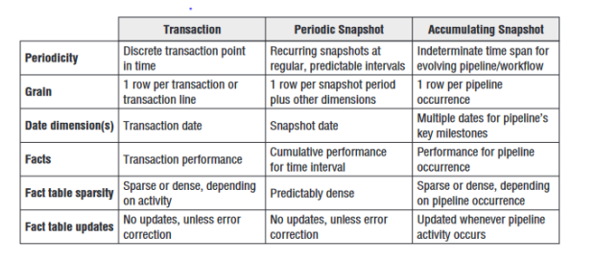
Fact Table Types
There are just three fundamental types of fact tables: transaction, periodic snapshot, and accumulating snapshot. Amazingly, this simple pattern holds true regardless of the industry.

Slide 14
Transaction Fact Tables
The most fundamental view of the business’s operations is at the individual transaction or transaction line level. These fact tables represent an event that occurred at an instantaneous point in time. A row exists in the fact table for a given customer or product only if a transaction event occurred. Transaction data fits easily into a dimensional framework.

Slide 15
Periodic Snapshot Fact Tables
Periodic snapshots are needed to see the cumulative performance of the business at regular, predictable time intervals. The periodic snapshots are stacked consecutively into the fact table When transactions equate to little pieces of revenue, you can move easily from individual transactions to a daily snapshot merely by adding up the transactions

Slide 16
Accumulating Snapshot Fact Tables
Accumulating snapshots represent processes that have a definite beginning and definite end together with a standard set of intermediate process steps. Accumulating snapshots are most appropriate when business users want to perform workflow or pipeline analysis.
Lags Between Milestones and Milestone Counts
Accumulating snapshot fact tables sometimes include milestone completion counters, valued as either 0 or 1. Finally, accumulating snapshots often have a foreign key to a status dimension, which is updated to reflect the pipeline’s latest status.
Accumulating Snapshot Updates and OLAP Cubes
It is worth noting that accumulating snapshots are typically problematic for OLAP cubes. Because updates to an accumulating snapshot force both facts and dimension foreign keys to change, much of the cube would need to be reprocessed with updates to these snapshots, unless the fact row is only loaded once the pipeline occurrence is complete

Slide 17
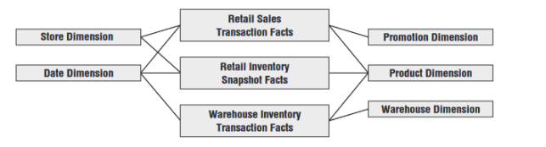
Value Chain Integration
IT managers recognize integration is needed to deliver on the promises of data warehousing and business intelligence Many consider it their fiduciary responsibility to manage the organization’s information assets.
IT also benefits from integration because it allows the organization to better leverage scarce resources and gain efficiencies through the use of reusable components

Slide 18
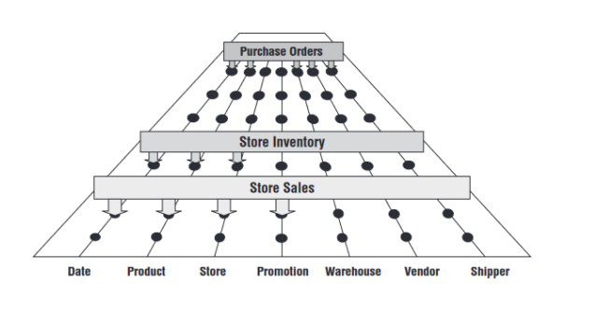
Enterprise Data Warehouse Bus Architecture
you need to use an architected, incremental approach to build the enterprise’s warehouse. The approach we advocate is the enterprise data warehouse bus architecture
Understanding the Bus Architecture The enterprise data warehouse bus architecture provides a rational approach to decomposing the enterprise DW/BI planning task The bus architecture enables DW/BI managers to get the best of both worlds. The bus architecture is independent of technology and database platform

Slide 19
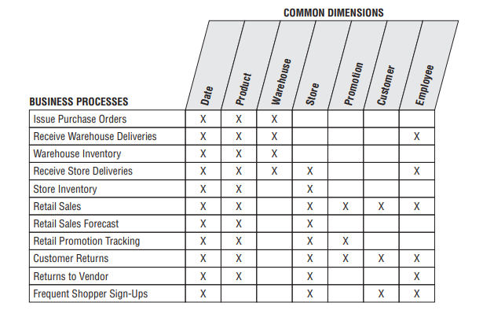
Enterprise Data Warehouse Bus Matrix
We recommend using an enterprise data warehouse bus matrix to communicate the bus architecture, as illustrated in Figure. Others have renamed the bus matrix, such as the conformance or event matrix, but these are merely synonyms for this fundamental Kimball concept first introduced in the 1990s.

Slide 20
Enterprise Data Warehouse Bus Matrix
The matrix rows into dimensional models representing the organization’s primary activities and events, which are often recognizable by their operational source.
The number of bus matrix rows and columns varies by organization
For many, the matrix is surprisingly square with approximately 25 to 50 rows and a comparable number of columns. In other industries, like insurance, there tend to be more columns than rows.

Slide 21
Multiple Matrix Uses
Creating the enterprise data warehouse bus matrix is one of the most important DW/BI implementation deliverables
The matrix’s columns address the demands of master data management and data integration head-on.
The matrix enables you to communicate effectively within and across data governance and DW/BI teams.
IT management needs to understand this perspective to coordinate across project teams and resist the organizational urge to deploy more departmental solutions quickly

Slide 22
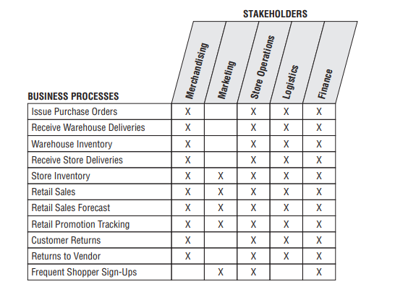
Opportunity/Stakeholder Matrix
You can draft a different matrix that leverages the business process rows, but replaces the dimension columns same with business functions, such as marketing, store operations, and finance.
Based on each function’s requirements, the matrix cells are shaded to indicate which business functions are interested in which business processes (and projects), as illustrated in Figure opportunity/stakeholder matrix variation.

Slide 23
Common Bus Matrix Mistakes
When defining the matrix columns, architects naturally fall into the similar traps of defining columns that are either too broad or too narrow:
■ Overly generalized columns. A “person” column on the bus matrix may refer to a wide variety of people, from internal employees to external suppliers and customer contacts.
■ Separate columns for each level of a hierarchy. The columns of the bus matrix should refer to dimensions at their most granular level.

Slide 24
Retrofitting Existing Models to a Bus Matrix
It is unacceptable to build separate dimensional models that ignore a framework tying them together. Isolated, independent dimensional models are worse than simply a lost opportunity for analysis.
Can you rescue your stovepipes and convert them to the bus architecture? To answer this question, you should start first with an honest appraisal of your existing non-integrated dimensional structures.

Slide 25
Conformed Dimensions
Conformed dimensions go by many other aliases: common dimensions, master dimensions, reference dimensions, and shared dimensions.
Conformed dimensions should be built once in the ETL system and then replicated either logically or physically throughout the enterprise DW/BI environment.
When built, it’s extremely important that the DW/BI development teams take the pledge to use these dimensions. It’s a policy decision that is critical to making the enterprise DW/BI system function

Slide 26

Drilling Across Fact Tables
In addition to consistency conformed dimensions enable you to combine performance measurements from different business processes in a single report, as illustrated in Figure.
Drilling across is supported by many BI products and platforms.
The vendors also use different terms to describe this technique, including multipass, multi-select, multi-fact, or stitch queries

Slide 27
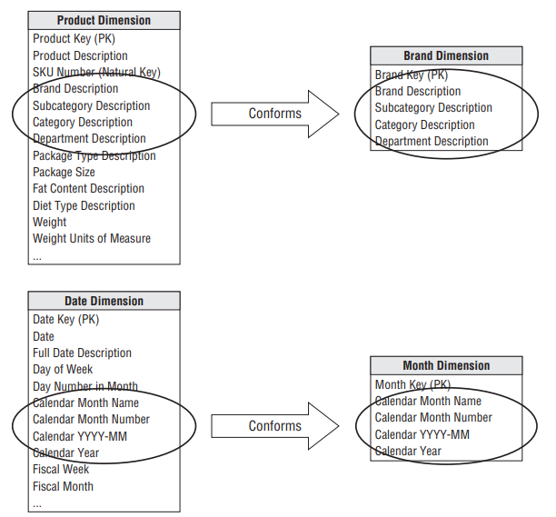
Shrunken Conformed Dimension with Row Subset
Another case of conformed dimension subsetting occurs when two dimensions are at the same level of detail, but one represents only a subset of rows. For example, a corporate product dimension contains rows for the full portfolio of products across multiple disparate lines of business, as illustrated in Figure

Slide 28
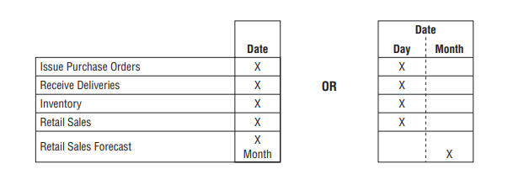
Shrunken Conformed Dimensions on the Bus Matrix
The bus matrix identifies the reuse of common dimensions across business processes.
Typically, the shaded cells of the matrix indicate that the atomic dimension is associated with a given process.
Instead, there are two viable approaches to represent the shrunken dimensions within the matrix, as illustrated in Figure

Slide 29
Importance of Data Governance and Stewardship
In many organizations, business rules and data definitions have traditionally been established departmentally. The consequences of this commonly encountered lack of data governance and control are the ubiquitous departmental data silos that perpetuate similar but slightly different versions of the truth.
Business and IT management need to recognize the importance of addressing this shortfall if you stand any chance of bringing order to the chaos;

Slide 30
Business-Driven Governance
To boost the likelihood of business acceptance, subject matter experts from the business need to lead the initiative
The governance resources identified by business leadership should have the following characteristics:
■ Respect from the organization
■ Ability to balance organizational needs against departmental requirements
■ Strong communication skills
■ Politically savvy negotiation and consensus building skills

Slide 31
Summary
Finally, most inventory analysis will require a transactional schema to augment these snapshot models. We introduced key concepts surrounding the enterprise data warehouse bus architecture and matrix

